Slide 1

Research Budget Training – Session 4
Closing and Opening the Year: FY 21 Expenditure Reports, FY 22 Execution and Expectations
September 28, 2021
John Verwiel
Antonio Laracuente
Kari Points
Jason Berlow
Dial in: 1 – 404 – 397 – 1596
Access Code: 2762 -149 - 9772
Slides in “Handout” Tab

Slide 2
Commitment to the Enterprise
ORD relies on each station to independently manage the budgets allocated to facilities. One major factor to consider is how effective management of funding at the local facility impacts the overall appropriation.
We understand the constant pressures on spending and the limitations from hiring and executing the budget.
However, we need to continue the message: “SPEND the MONEY you GET in the Year you get it!”

Slide 3
Prior Trainings
Prior training can be located at the ORPP&E Archive Training
  https://www.research.va.gov/programs/orppe/education/webinars/archives.cfm

Slide 4
How do we go about this
Continue to work to notify investigators that Carryover is no longer acceptable – money is expended in the year allocated (think 1 year money)
Work closely with investigators and if spending execution is not occurring, then contact the ORD/Service project officer to determine solutions (PMO)
Plan ahead. If needed, send money back before the end of Q2
Utilize existing financial software and tools to manage budgets
Understand the money cycle and who is responsible
Accountability – Research Offices will need to be involved in the detailed management of projects in FY 22

Slide 5
The Money Cycle Responsibilities
ORD will hold the Research Offices accountable for execution.
Research Offices should work closely with the investigators and Center administrative staff to ensure execution.
Centers need to notify Research Office staff when additional funding is requested or offered by ORD Services prior to accepting funds.
Research Office needs to determine how additional funding impacts carryover.
Review project start dates to ensure that execution can occur.
  Do not accept funding until investigator is on board or has on-board date

Slide 6
Additional Reporting will continue in FY 22
RAFT has been utilized by the field as an informational tool
Effective this year, expenditure execution field will be incorporated into RAFT
  Each quarter cumulative FY expenditures will be reported into RAFT
  This will be one lump sum per project – only CY funds reported
  ORD will review to determine if projects are under executing and may request additional information
Research Offices will be the POC for these discussions.

Slide 7
ORD Expectations of the field
Honesty and Integrity: Once you lose that relationship, it is very hard to re-establish
We expect you to know the basics of fiscal law and act accordingly. Know Purpose, Time, and Amount (PTA); You have dollars given to you for a specific purpose to be obligated during a particular time not to exceed a certain amount.
Return money in a timely manner
We try to have open communications with the field. We will attempt to answer your questions as quickly as we can. When we ask for information, we expect a response.
ORD has tried to foster a closer relationship with your VISN CFOs. We understand the dynamics of working with over 100 different fiscal offices and officers. We will try to give you information and guidance to help you in this relationship. Bottom line however is that your local CFO will dictate various interpretations of policy and regulation. We encourage you to build a trusting and supportive relationship with this individual.
No matter what we say today, we try to never forget you folks must implement – you are where the rubber meets the road

Slide 8
Fiscal Philosophy and Guidance
The goal is to provide the field only dollars that are needed and executable during a particular fiscal year.
Slowly work to realign your service contracts to have a period of performance that doesn’t start in the 1st Quarter of the Fiscal Year.
Process appropriate Interagency Agreements through FSC per their guidance. Actual collection and processing of the IPAC will be done at the station level.
Do not mix research appropriation and medical service appropriation for same mission/requirement
ORD offers WinRMS as a local fiscal management tool that drills down to the project level. Though not currently mandated, I highly encourage you to learn and use this package for your local management.

Slide 9
Today ‘s presentation
RAFT Expenditure Report
Understand ORD expectations for the use of BFY 21/22 funds
Understand ORD expectation for managing FY 22/23 funds
Current status of FY 22 Budget
Details and tips on how to Close out FY 21 and open FY22

Slide 10
RAFT Expenditure Report
Due on October 15, 2021
This is a cumulative report
  Report Expenditures from the 21/22 appropriation (Current Year) only
    Do not report PY expenditures
    It is critical that the numbers are cumulative for the fiscal year. Do NOT enter 4th qtr expenditures only. Must be whole year
  Will be looked at by Finance and the Service Directors/Portfolio Managers
    Trend expenditure to Allocation
Training sessions have been set for September 29 and 30 at 2:30 PM EST

Slide 11
Current Status of 21/22 Funds
Projected Carryover of $120 Million
Includes A1, R1, and X2 funds
Spread out through many sites
Few hit the 4% target

Slide 12
Rules of engagement for FY 22 PY Funds
Carryover of FY 21/22 funds in the 161A1 appropriation must be obligated (not committed) by 1/10/2022 and balances across all programs at the local facilities must be zero by 1/15/2022.
So how are we going to accomplish this:
  Designate 1 or more people to enter data into sharepoint
  Gather your financial data
  Verify that the expenditure data submitted in RAFT are correct
  Complete the Sharepoint
  Track your expenditures
  Zero out your reimbursable funds (0161R1 21/22 and X2)

Slide 13
Plans – Required for >4%
Facilities carrying over >4% of the total 0161A1 FY 21/22 allocation must provide ORD Finance a budget plan by 11/1/2021 outlining the following (via SharePoint form):
  Amount of carryover by Program (820, 821, 822, 824, 825, 826, 829)
  Amount of carryover by Service ID (these will be checked against the RAFT expenditure report and overall FMS balance)
  Plan by program to obligate funds
    Projected Payroll cost by program for PP 21
    Number of Pay Periods required to utilized funding
    Amount projected to be obligated through 1358s
    List of Contracts that were not obligated by 9/30/2021 that were rolled into 1st quarter using PY funds as long as the contract can be executed by 12/31/2021.
  Service ID specific data will be requested for projects carrying over a balance of >$15,000.

Slide 14
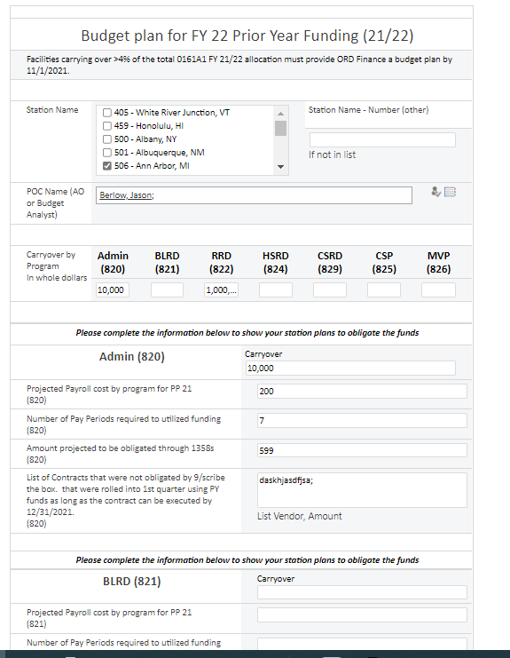
Sharepoint site – Overall

Slide 15
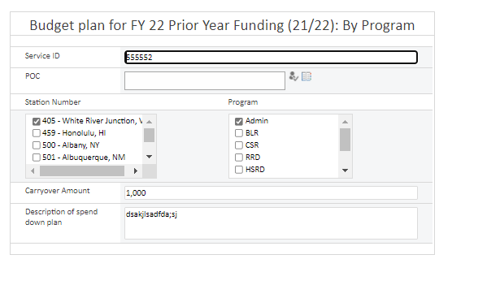
Sharepoint site – by Service ID
Projects with >$15,000 carryover are required to submit an individual plan

Slide 16
Guidelines
All facilities with a carryover will follow these guidelines in executing PY funds:
  Determine your payroll costs per pay period
  Project how many pay periods you will need to draw down funding
  Request Expenditure Transfers for Salary from current year to prior year every two pay periods (approximately 3 formal requests through January 10)
  Determine IPA needs and obligate or increase 1358s as needed.
  Request movement of ceilings by the local Fiscal Service to allow for execution of salary and 1358s.
  Funds should not be used for travel, new contracts (unless authorized by ORD Finance), or equipment. Purchases may be made by purchase card through November 15, 2021 as long as all purchases can be reconciled by 1/10/2022.

Slide 17
So what will happen January 15, 2022
Regardless of program, balances remaining in the 21/22 0161A1 on 1/15/2022 will be swept by ORD Finance for redistribution. The sweep will NOT be service ID specific.
  For sites with investigators who have balances, you will have to work to find them money or let them know the money was swept
  PY money may be redistribute to sites who can quickly obligate
  Focus on CY funding

Slide 18
Reimbursable funding
Reminder that reimbursable funds are collected to reimburse the appropriation
Many are missing the final step
  Cost transfer from where the cost was incurred to the 0161R1 or X2 fund
Stations are carrying over the balance
Need the 0161A funds made whole for use in 1st quarter

Slide 19
What is the status of the FY 22 Budget
The FY 2022 Request is $882 Million.
  A Continuing Resolution is under consideration on the Hill (but the path forward is unclear at this time.
As the week continues further guidance will occur about a potential lapse in appropriation.
We will operate with carryover (0161A1-21/22).
  We will have enough funding for approximately 2 months.
  Will prioritize payroll and maintaining life/property.
  We will monitor unobligated balances by stations to ensure payroll is met.

Slide 20
FY 22 Current Year Funding (assuming we are under CR)
While waiting for FY 2022 Enactment, pre-planning of studies must commence so we are “shovel ready” thirty days after enactment.
  Continue to hire personnel and execute IPAs during the continuing resolution.
  Utilize current year funding (2022/2023) for Contracting purposes
  Develop packages for equipment and other infrastructure needs that can be obligated in FY 22.
  Work with investigator to develop rapid response projects
  Educate field on JIT process (commencing hiring and contracting timelines sooner)

Slide 21
Closing and Opening the Year Tips
In October each year, you will close out the previous fiscal year in WinRMS. Once you have closed it out, no more downloads or entries should occur.
When setting up the new fiscal year, you will want to make note that these FCPs are now Prior Year.
The remaining balances from each Prior Year (PY) FCP will need to be entered. This can be found by either looking at your previous fiscal year ending balance in WinRMS or from the Status of Allowance (SOA - FMS). For salaries, you need to account for accruals and PP20 split.
To enter the remaining balance for each PY FCP in the new fiscal year, you will want to allocate the amount to the FCP and then distribute to the accounts.
I recommend no longer downloading the PY FCP and doing manual entries of any adjustments/items.

Slide 22
Final Balance of Salary FCPs
In WinRMS Session 2, we discussed how to balance salary FCPs.
This session will focus on the accruals and final Pay Period 20 split between this fiscal year and next.
Each year, WinRMS will publish a Pay Calendar List. This list shows how WinRMS accounts for accruals and is particularly important at the end of the year. It can be found by going to: Reports -> Employee – Salary Reports -> Pay Calendar List

Slide 23
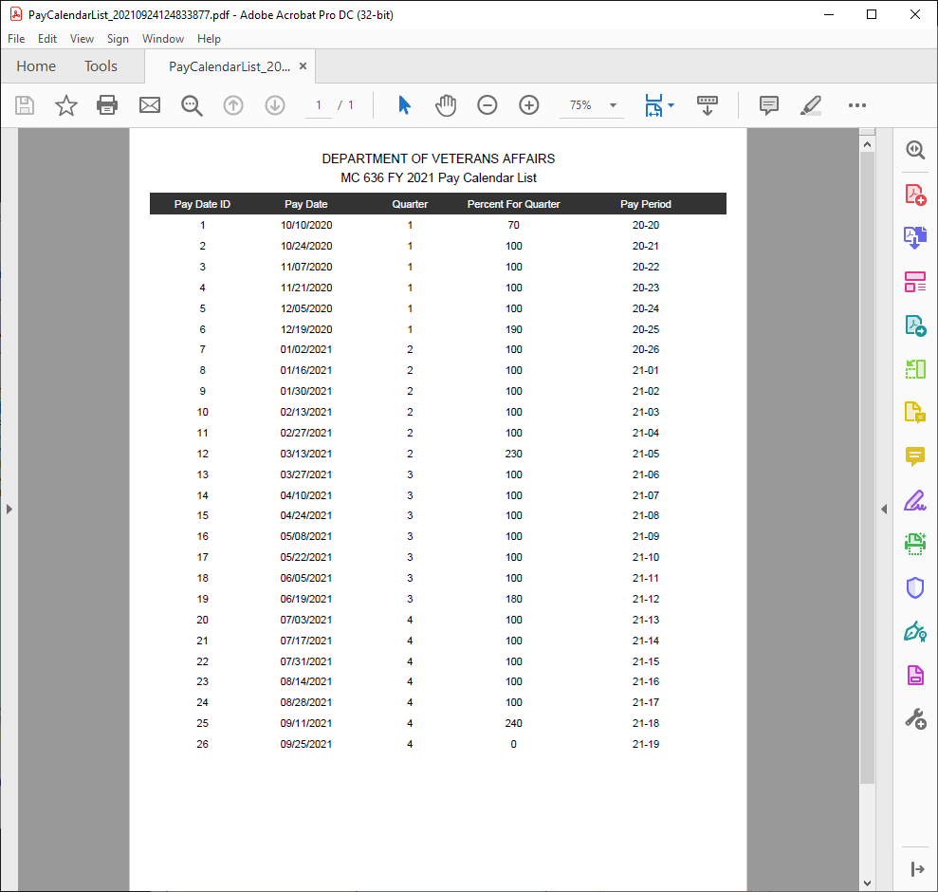
Here is the Pay Calendar for FY21.
You can see that when PP18 downloads, it is accounting for 240% and then PP 19 is showing at 0%.
This is because PP 19 and 4 days of PP20 will hit the FY21/22 Salary FCP. However, it doesn’t occur until after October 1st.
WinRMS is accounting for that and entering the 1.4 pay periods as an accrual.
When you go to balance your final salary FCPs this is why you might be off slightly from what the SOA says actually hit the FCP and what WinRMS estimated based on accruals.

Slide 24
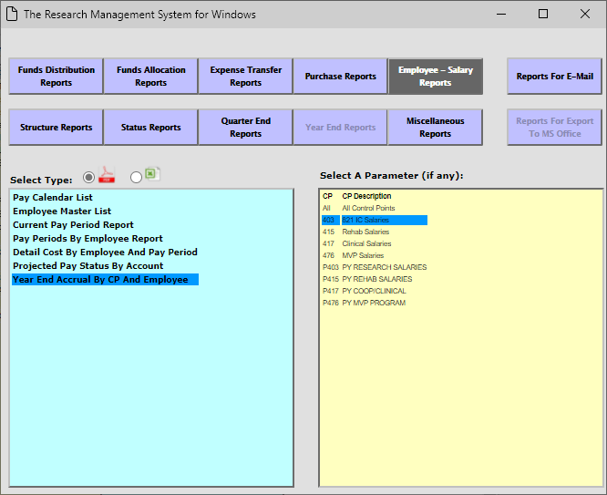
WinRMS Accrual Report
If you want to know what WinRMS determined to be the accrual amount by individual, there is a new report for that.
Go to Reports -> Employee-Salary Reports -> Year End Accrual By CP and Employee. Then select on the FCP that you want to view.

Slide 25
Pay Period 20 Split
Pay Period 20 is split between the fiscal years. PP20 will download into the new fiscal year in WinRMS, but you can see from the FY21 Pay Calendar that it was only factored at 70%.

Slide 26
Pay Period 20 Split (cont)
In order to determine the salary amount that was split between fiscal years, you can view the F20 report in the VSSC - VSSC - VHA Support Service Center (va.gov)
Select F20D – Daily Activity by Account Classification Code
You can see below there were two transactions for PP20
If you have been tracking your salaries via spreadsheet, you will want to enter the PP20 split.
Fund | Station | A/O | BFY | Run Date | Transaction Date | ACC No | Document ID | BOC | Cost Ctr | Cost Ctr (6 digit) | Vendor Name | Budget Ceiling Beginning Balance | Ceiling Adjustment Amount | Budget Ceiling Ending Balance | Obligations Beginning Balance | Obligation Adjustment Amount | Unobligated Ending Balance
0161A1 | 636 | 10 | 20 | 20201020 | 20201019 | 810034401 | PR 636PP20 | 11 | 8101 | 810100 |  | $1,116,067.00 | $0.00 | $1,116,067.00 | $867,487.08 | $16,174.07 | $232,405.85
0161A1 | 636 | 10 | 21 | 20201020 | 20201019 | 810034401 | PR 636PP20 | 11 | 8101 | 810100 |  | $0.00 | $0.00 | $0.00 | $0.00 | $38,957.66 | ($38,957.66)

Slide 27
How do you use this information to balance?
You first need to look at your balance on the SOA. For salaries, I always balance to the FMS Obligation column.
FCP | ACC | FCP Name | FMS Budget | FMS Oblig | FMS Unob
403 | 810034401 | 821 IC SALARIES | 1,116,067.00 | 883,661.15 | 232,405.85

Slide 28
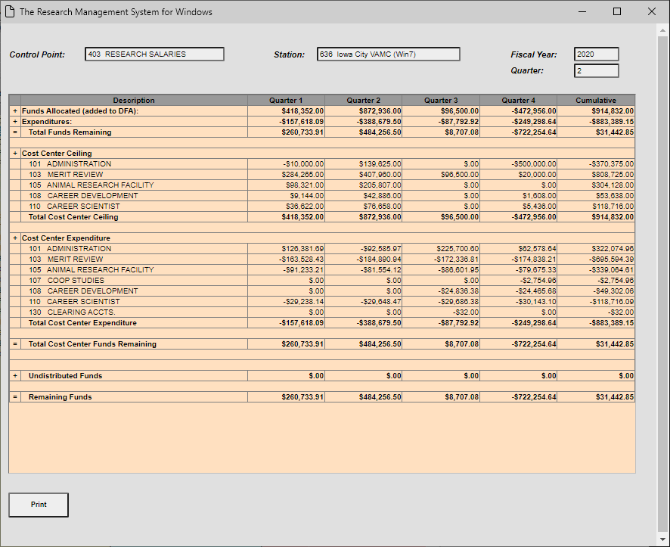
How do you use this information to Balance?
Find the Salary Balance in WinRMS by clicking on the FCP and then select Detail Status OR Click on Reports -> Status Reports -> Administrators Summary Report

Slide 29
How do you use this information to balance?
Pay #24 Period 20-17 9/4/2020 | 59414.22
Pay #25 Period 20-18 9/17/2020 | 59344.1
Pay #26 Period 20-19 9/26/2020 | 55782.82
Pay Period 20 SPLIT 10/19/20 | 16174.07
Total | 883,661.15
SOA | 883661.15
RMS | 883389.15
Difference | 272.00
After Adj RMS | 883661.15
This is a screenshot of the last few transactions entered on the spreadsheet I utilize to track salaries through the year.
Why is there a difference? This goes back to the accruals. WinRMS is projecting what the final PP totals will be. It is not exact. You then need to enter a manual entry into WinRMS to adjust.

Slide 30
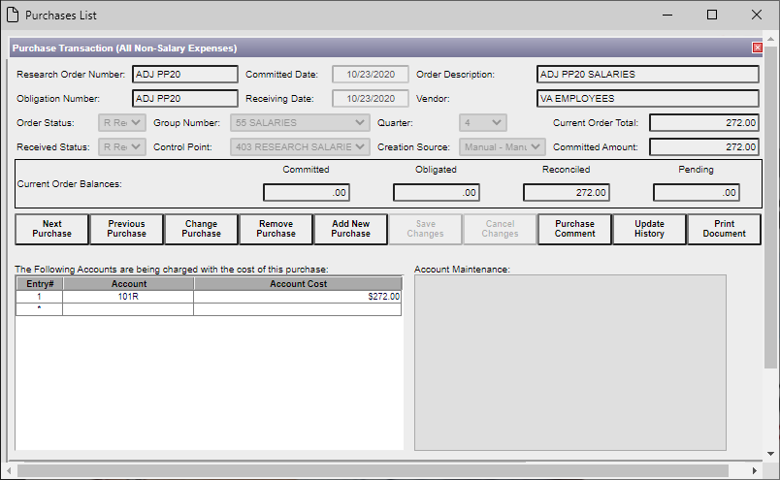
Manual Entry of Adjustment

Slide 31
Final Balance of All Other FCPs
In WinRMS Session 3 we discussed how to balance the All Other FCPs in detail.
You need to ensure that the balance on the All Other FCP on the SOA and the remaining amount in WinRMS balance.
SOA for FCP 4610
Remember: You take the Unobligated Funds and Subtract the IFCAP pending to arrive at your remaining balance: $74,014.76.
FCP | ACC | FCP Name | FMS Budget | FMS Oblig | FMS Unob | IFCAP Unob | IFCAP Pending
4610 | 8100101GB | 821 IC S&S 20/21 | 5,572,411.00 | 5,475,762.49 | 96,648.51 | 22,538.81 | 22,633.75

Slide 32
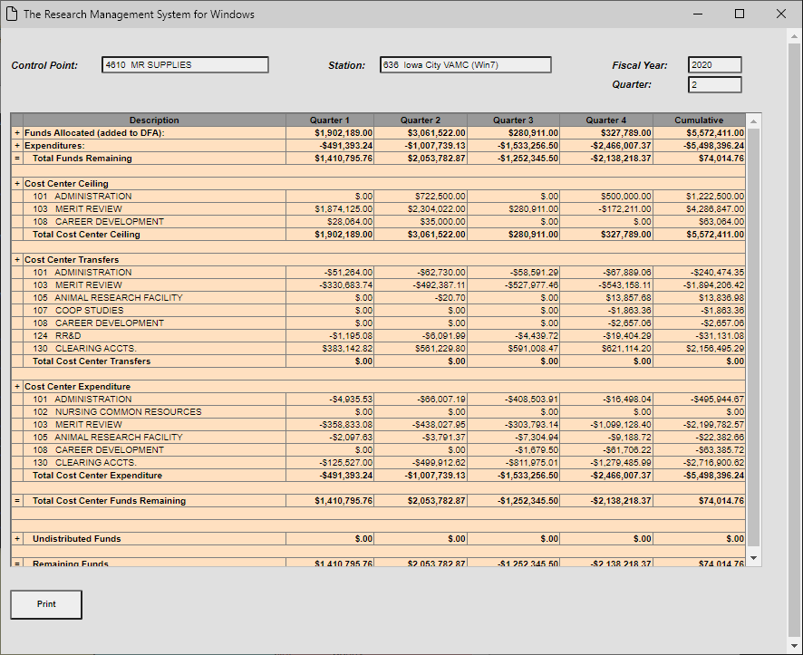
Final Balance of All Other FCPs
Verify that the SOA balances to WinRMS.

Slide 33
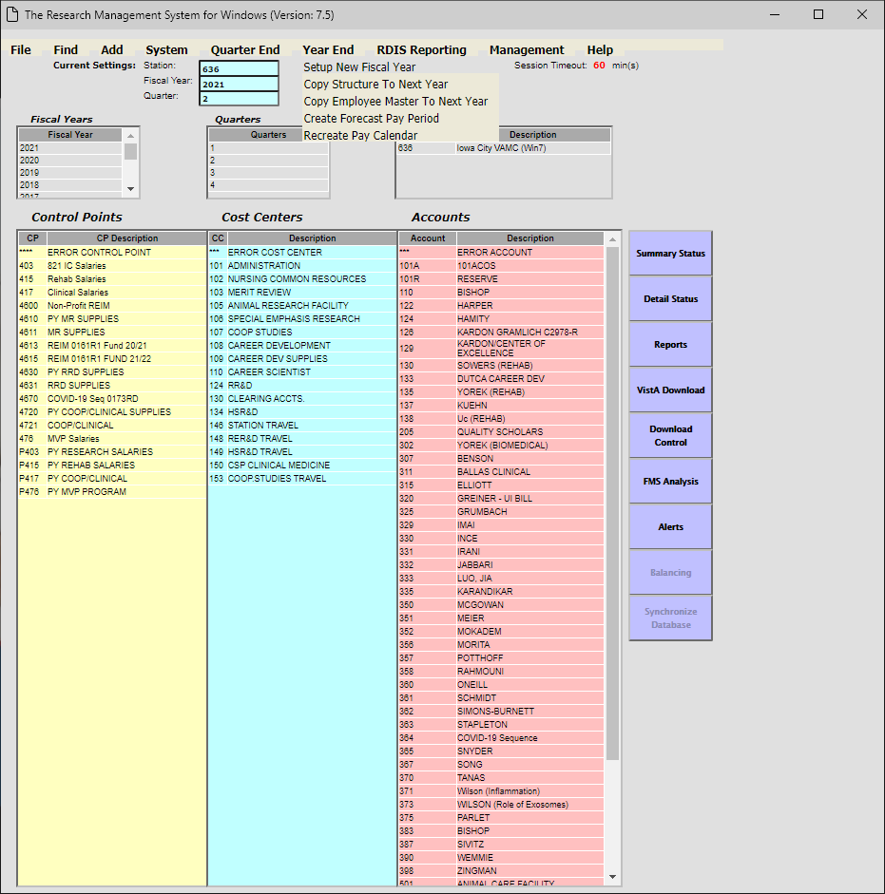
Setting up New Fiscal Year
You now have balanced all your FCPs and closed out the fiscal year. It is time to set-up the new fiscal year.
Go to Year End and Click on Setup New Fiscal Year. It will walk you through the steps.
The next slides are covered in much more detail in WinRMS Session 1

Slide 34
Setting up New Fiscal Year (Cont)
Once your Fiscal Year is set-up, ensure that you:
Update FCPs
  You will want to delete the FCPs that are no longer in use (Last year’s PY). This can be done by going to Find -> Find Control Point -> And then clicking on the FCP and selecting Remove Control Point.
  For the All Other FCPs that are now PY, you will want to edit them to make note of this and change the description to state PY. This can be done by going to Find -> Find Control Point -> And then clicking on the FCP and selecting Change Control Point.
  For the salary FCPs that don’t change numbers each year, you want to make sure you designate the PY FCP and still have it listed as a FCP in WinRMS. For example, CY would be FCP 403 and PY I designate as P403.
Update Accounts
Update Employees

Slide 35
Setting up New Fiscal Year - Prior Year Balances
Once Accounts are established, you will want to allocate and distribute the PY Balances. To find the number to put in:
WinRMS:
  Once the previous fiscal year is finalized in WinRMS, you can pull a report with the remaining balances. This can be done couple ways.
    Reports – Go to the Administrators Summary Report and look at the final amount in the Account Balances report. It will give the cumulative balance remaining in each FCP.
    Click on the Control Point on the home page in yellow and then click on either Summary Status or Detail Status in purple. This will show you the Total Funds Remaining.
Status of Allowance
  On the SOA, look at the FMS Unobligated balance for each FCP.

Slide 36
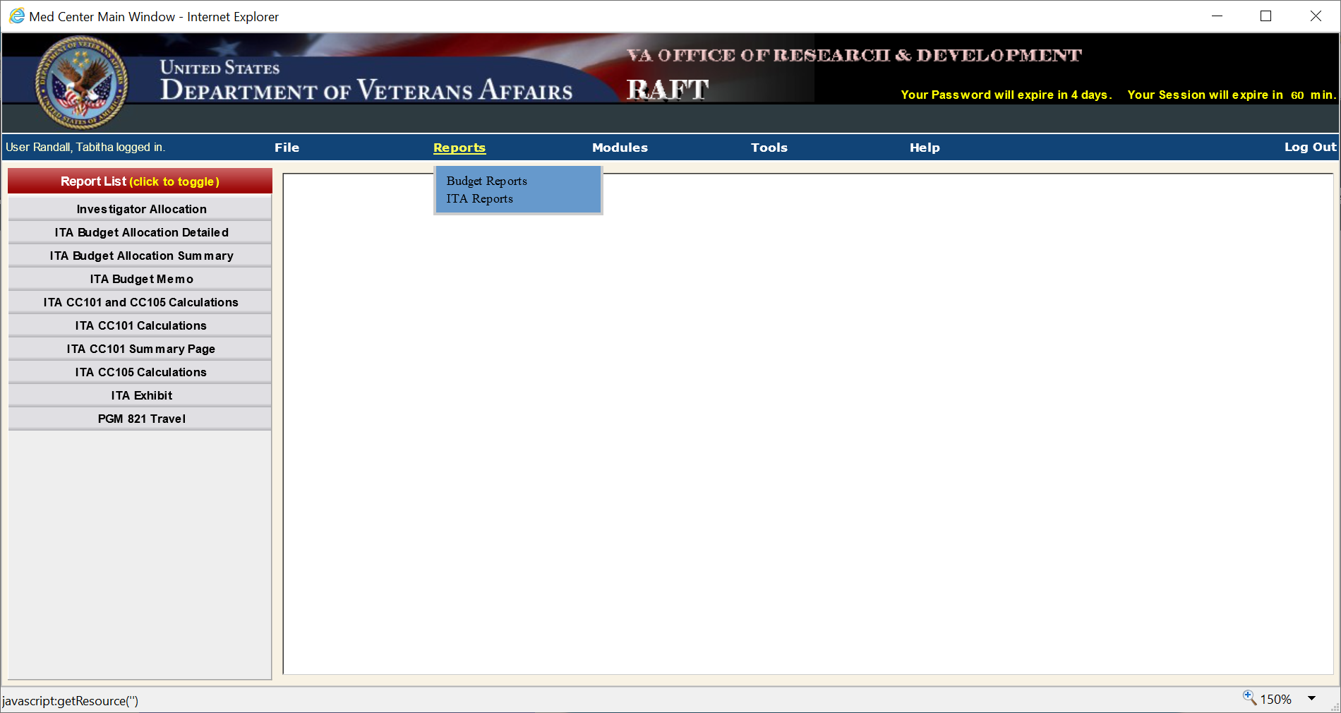
Setting up New Fiscal Year – Current Year FCPs
You will need the Initial Target Allowance (ITA) from RAFT to know the amount to allocate to the FCPs and distribute to the accounts.
Hover over Reports
-Select ITA Reports
-Select ITA Budget Memo

Slide 37
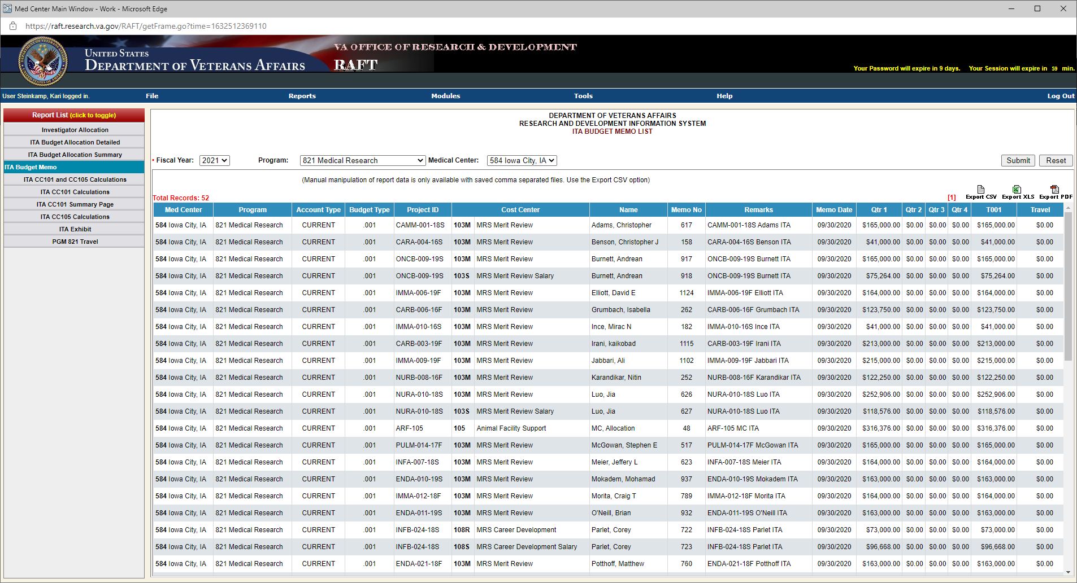
Setting up New Fiscal Year – Current Year FCPs

Slide 38
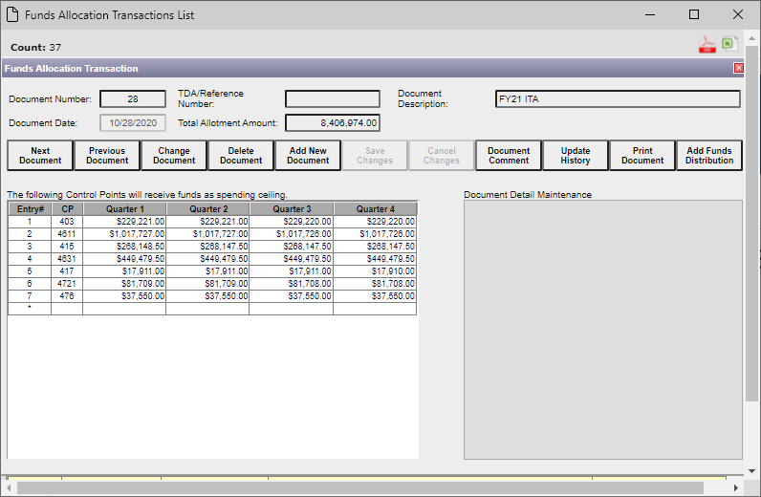
Allocation and Distribution
Remember: You allocate the funds to the FCP and then distribute them to the accounts.
Allocation:

Slide 39
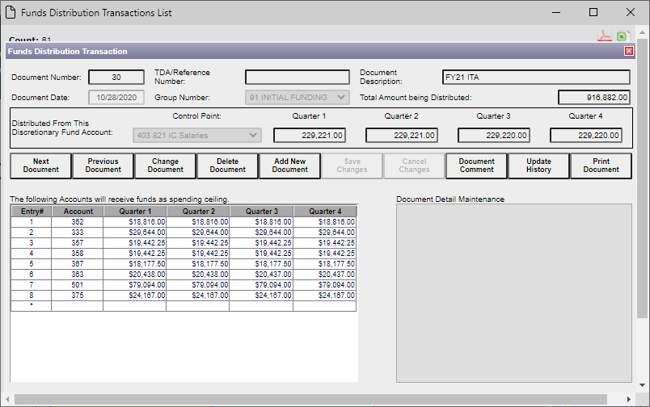
Allocation and Distribution
Distribution:

Slide 40
Best Practices – Prior Year All Other FCPs
I do not recommend utilizing PY FCPs for credit card transactions. Once October 1st hits, inform your purchasing agents that they need to use Current Year FCPs only.
Do not download PY FCPs into WinRMS. If you do so, this will cause pending transactions to download into the new fiscal year that have previously hit the prior fiscal year causing duplication.
Any adjustments that your purchasing agent makes will need to be manually entered into WinRMS to continue balancing.

Slide 41
Expectations
Spend the money you get
Very little carryover – plan on 4% but may be less
Get you contracts in early
Initiate the hiring process as soon as you get your intent to award email
Meet with the PI to see how progress is going. May have to include portfolio managers

Slide 42
Availability of Recording
A recording of this session and the associated handouts will be available on ORPP&E’s Education and Training website approximately one-week post-webinar
An archive of this and other webinars can be found here: https://www.research.va.gov/programs/orppe/education/webinars/archives.cfm

Slide 43
Questions ????????

